Slide 1
Introduction to Data Science
Group 5
Wan Mohammed Adam (0132601)
Tripti Pal Kaur (0132648)

Slide 2
Problem Statement
Today’s fuel market is overly complex due to many factors such as geopolitical factors where the supply and demand of fuel is affected by natural disasters, sanctions, wars and political instability.
It is also complex due to the economic factors such as currency exchange rates, inflation, interest rates and Gross Domestic Product (GDP) growth.
Due to the complexity of the fuel market, it is important to be able to predict the fuel price for individuals and businesses.
Hence, in this report, we will be predicting the fuel price using two different datasets and two different machine learning models.

Slide 3
Problem Solution
2 supervised learning models will be used : Linear Regression and Random Forest Regression → To find out which model will give the best accuracy and performance.
The values outputted by the algorithms will be compared with the real time values to see which model would provide the closest value to the real time value.
The machine learning technique that is used is Time Series Analysis which is a technique that forecasts target values based on a known history of target values.
We found 10 papers for our Literature Review and most of it found Random Forest Regression to be a better model in terms of prediction.

Slide 4
Research Question and
Hypothesis
Research Question : to investigate the use of two different machine learning models, Linear Regression and Random Forest Regression, to predict the fuel prices of the two different datasets.
Hypothesis : Random Forest Regression is a better machine learning model in terms of accuracy and performance to predict the fuel price compared to Linear Regression.

Slide 5
Methodology (1)
Data Collection
The two datasets that we used in this study were from online websites as there are existing databases with loads of data that are currently available on the internet.
The first dataset we found was from the Open Department of Statistics Malaysia (OpenDOSM) website where there were many different types of datasets.
The second dataset that we used in the study was obtained from a website called US Energy Information Administration (EIA).
Data Preprocessing
Import necessary libraries
Load data
Use pandas functions such as head, tail, info, describe to analyze the dataset
Check for missing values
Fill in missing values with mean/median
Split the dataset
Plot graphs such as heatmap, boxplot

Slide 6
Methodology (2)
Data Modelling
Why we chose Linear Regression?
Linear Regression is a common statistical method for modelling the relationship between the independent variables and dependent variables. Linear regression is usually used in mathematical research methods where the prediction needs to be measured and model them against multiple input variables (Maulud and Abdulazeez).
It is a simple and interpretable model which can provide information about the relationship between the variables. Another advantage for linear regression is the linearity which makes the estimation procedure simple (Christoph Molnar).
Why we chose Random Forest Regression?
To predict the price of fuel due to its ability to provide accurate predictions and its comprehensibility.
Furthermore, compared to the decision tree algorithm, random forest regression is more accurate (Mbaabu).
Additionally, this model can effectively deal with non-linear relationships between the dependent and independent variables.
This model can also handle missing values and outliers much better than other machine learning models.

Slide 7
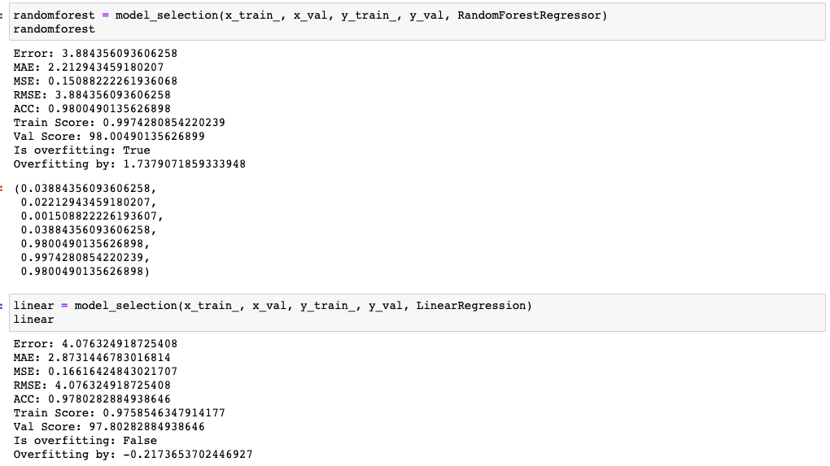
Results

Slide 8
Code Review

Slide 9
Discussion
Machine learning models, specifically RandomForestRegressor and LinearRegression, can effectively predict No 2 Diesel prices using historical data.
Model evaluation metrics (RMSE, MAE, MSE, and R2 score) indicate strong performance of both models, with RandomForestRegressor performing slightly better.
Previous studies also show promising results for machine learning models in predicting fuel prices.

Slide 10
Discussion
Study strengths: comprehensive analysis, robust preprocessing, and detailed evaluation of model performance
Study limitations: dataset limited to a specific region, no statistically significant findings for feature selection and dimensionality reduction, slight overfitting observed in RandomForestRegressor model

Slide 11
Thank You!

Slide 12
References
Rathnajyothi, Dr. CH., Amulya, C., Poojitha, S., & Varsha, N. (2021). PREDICTING CRUDE OIL PRICES USING MACHINE LEARNING. Jes Publication, 12(7). https://jespublication.com/upload/2021-V12I741.pdf
Shaik, Subhani. (2019). Machine Learning Algorithms for Oil Price Prediction. International Journal of Innovative Technology and Exploring Engineering. 8.
Smith, Paul F., et al. “A Comparison of Random Forest Regression and Multiple Linear Regression for Prediction in Neuroscience.” Journal of Neuroscience Methods, vol. 220, no. 1, Oct. 2013, pp. 85–91, doi: https://doi.org/10.1016/j.jneumeth.2013.08.024.
Pahlavan-Rad, Mohammad Reza, et al. “Prediction of Soil Water Infiltration Using Multiple Linear Regression and Random Forest in a Dry Flood Plain, Eastern Iran.” CATENA, vol. 194, Nov. 2020, p. 104715, doi: https://doi.org/10.1016/j.catena.2020.104715.
Zhang, Huan, et al. “Prediction of Soil Organic Carbon in an Intensively Managed Reclamation Zone of Eastern China: A Comparison of Multiple Linear Regressions and the Random Forest Model.” Science of the Total Environment, vol. 592, Aug. 2017, pp. 704–13, doi: https://doi.org/10.1016/j.scitotenv.2017.02.146.30
Lee, Hwang, et al. “Using Linear Regression, Random Forests, and Support Vector Machine with Unmanned Aerial Vehicle Multispectral Images to Predict Canopy Nitrogen Weight in Corn.” Remote Sensing, vol. 12, no. 13, 27 June 2020, p. 2071, https://doi.org/10.3390/rs12132071. Accessed 15 Dec. 2020.
Jui, Julakha Jahan, et al. “Flat Price Prediction Using Linear and Random Forest Regression Based on Machine Learning Techniques.” Embracing Industry 4.0, 2020, pp. 205–217, https://doi.org/10.1007/978-981-15-6025-5_19. Accessed 2 Apr. 2023.

